Slide 1

CSE (H) with specialization in Machine Learning and Artificial Intelligence
Soft Computing (CSF – 332)
Chapter -1.3
Neural Network Types
By: Dr. Monika Singh E11032
DISCOVER . LEARN . EMPOWER

Slide 2
Course Objectives
To introduce soft computing concepts and techniques of artificial neural networks, fuzzy sets, fuzzy logic and genetic algorithms
To understand the various techniques from the application point of view.
To analyze various soft computing techniques and decide the technique to be used in a particular problem situation.
To implement soft computing based solutions for real-world problems

Slide 3
Course Outcomes
CO1 | Identify and describe soft computing techniques and their roles in building intelligent. Machines | 1
CO2 | Recognize the feasibility of applying a soft computing methodology for a particular problem. | 2,4
CO3 | Apply fuzzy logic and reasoning to handle uncertainty and solve engineering problems, genetic algorithms to combinatorial optimization problems and neural networks to pattern classification and regression problems. | 3
CO4 | Effectively use modern software tools to solve real problems using a soft computing approach. | 3
CO5 | Evaluate various soft computing approaches for a given problem. | 4

Slide 4
Table of Contents
Learning Rules

Slide 5
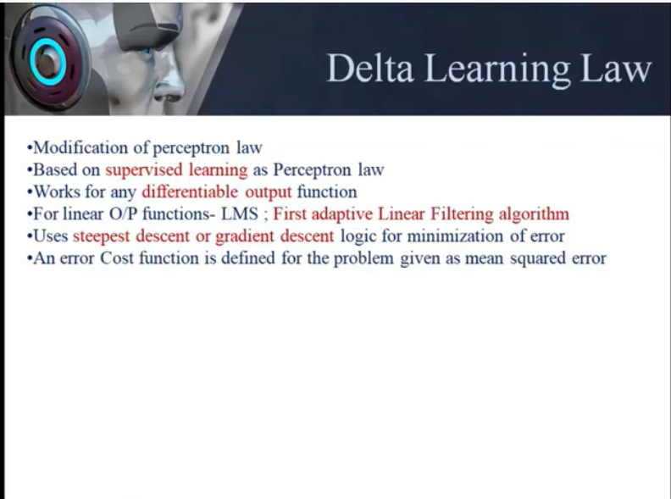

Slide 6
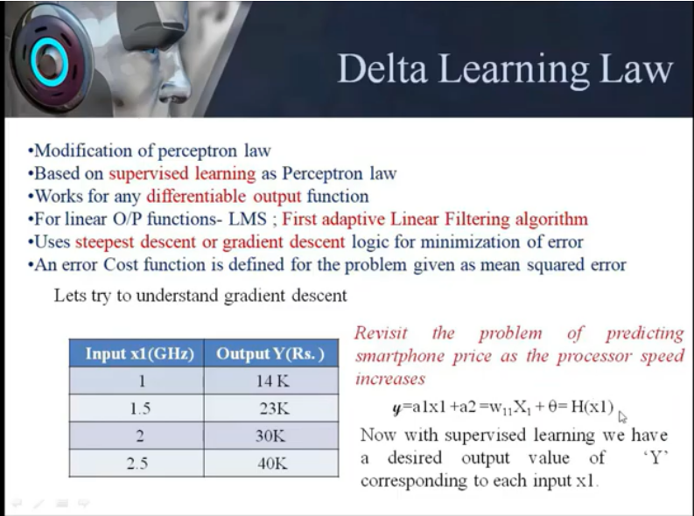

Slide 7
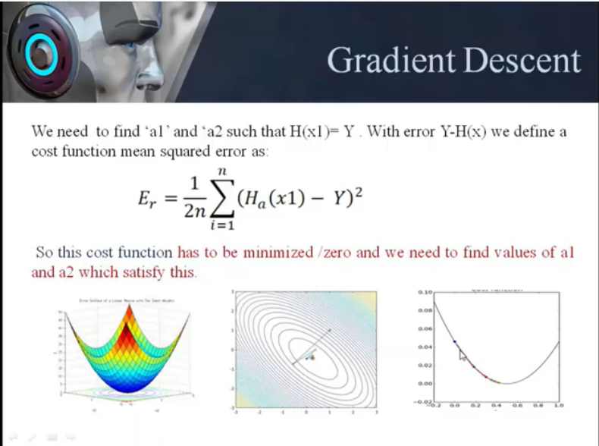

Slide 8
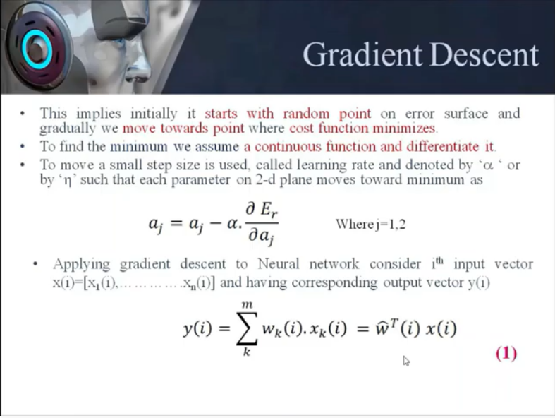

Slide 9
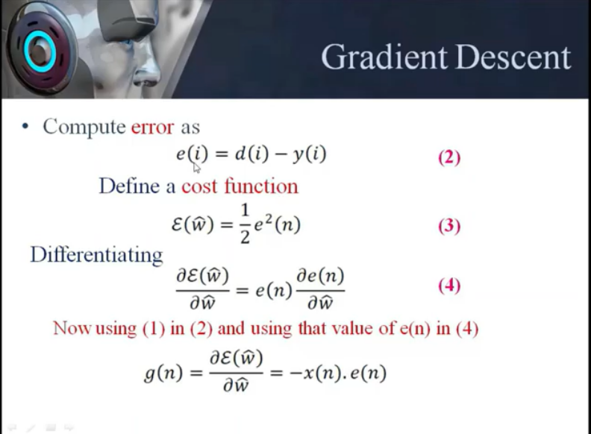

Slide 10
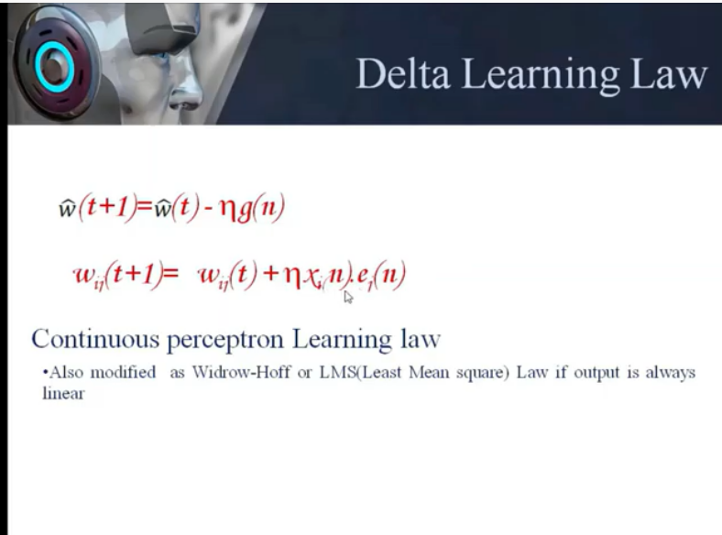

Slide 11
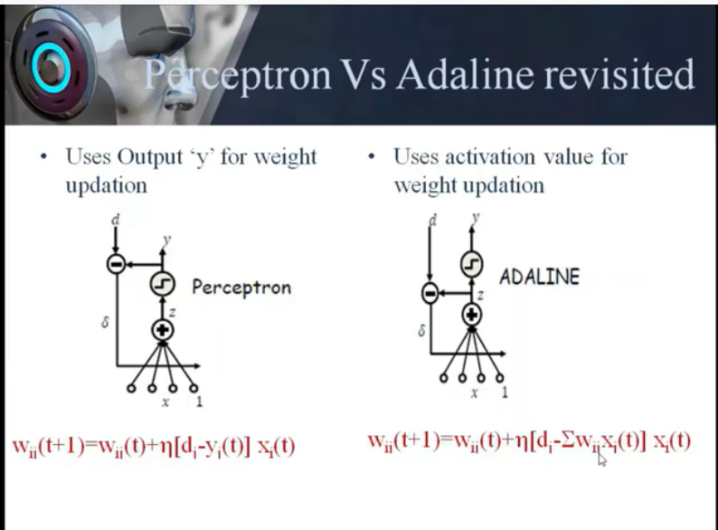

Slide 12
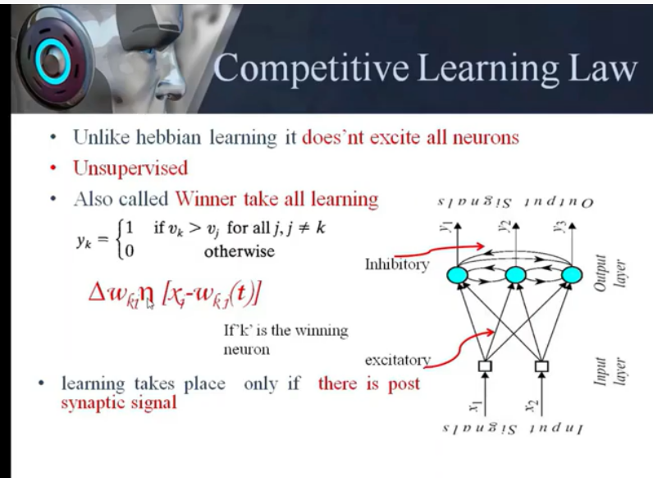

Slide 13
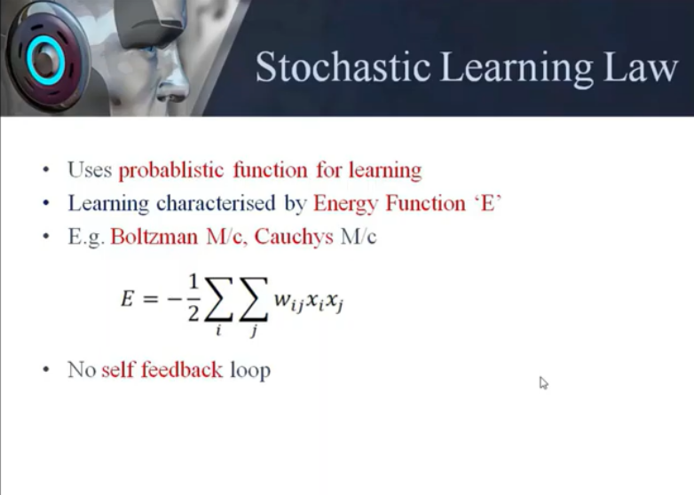

Slide 14
References
Book:
S.N.Sivanandam, S.N Deepa, “Principles of Soft Computing”
Journal Paper : https://www.sciencedirect.com/science/article/pii/S2405844018332067
Websites:
https://nptel.ac.in/courses/106/105/106105173/
MultiLayer Perceptron Learning Algorithm
http://www.cs.usyd.edu.au/~irena/ai01/nn/8.html
http://www.doc.ic.ac.uk/~nd/surprise_96/journal/vol4/cs11/report.html

Slide 15
THANK YOU
For queries
Email: monika.e11032@cumail.in

